Slide 1
Microplastics

Slide 2
What are microplastics?
Microplastics are plastic items with a diameter of less than 5 mm.
Microplastic pollution occurs everywhere in the marine environment.
The chemical reactions in which microparticles take part and how these particles affect organisms is still under study.
Research about the effects of nanoparticles, smaller than 1 μm, is also ongoing.
Microplastics and nanoplastics may have potential impacts on ecosystems.

Slide 3
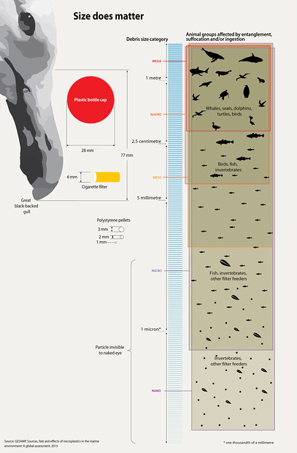
Microparticles: less than 5 mm
  large: 1 – 5 mm
  small: less than 1 mm
Nanomaterial: particle aggregate or agglomerate with size range 1 – 100 nm
(1 nm = 10⁻⁹ m or one millionth of a millimetre)
Ingested by invertebrates and filter feeders

Slide 4
How microplastics are generated
Sources of microplastic particles
Primary: made on purpose
  cosmetic products
  abrasive media for cleaning applications
Secondary: variety of sources
  accidental release of primary plastics
  industrial waste and by-products
  wear and tear of plastic products during normal use (textiles, paints, car tyres, etc.)
  particles and fibres

Slide 5
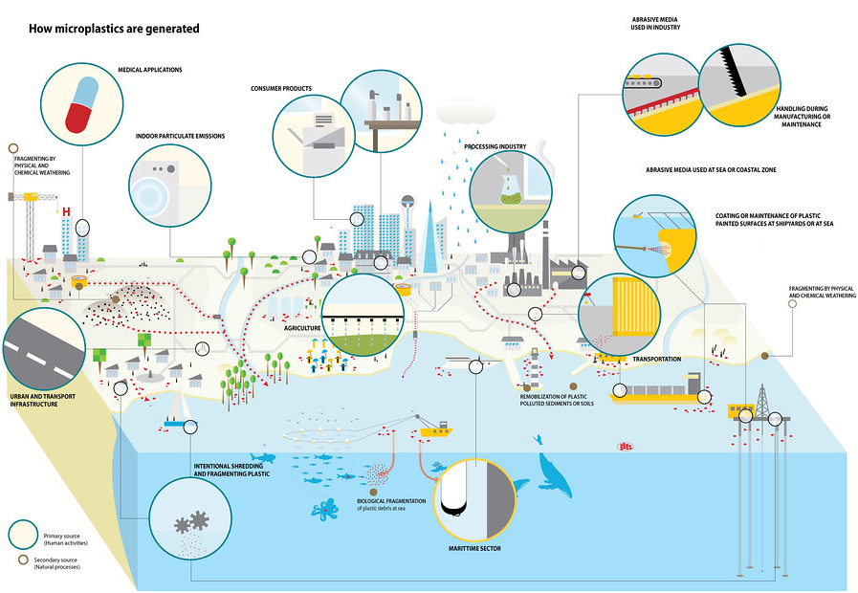

Slide 6
How plastics enter the food web
Swallowed by fish, mammals, birds, other sea animals
Microplastics are similar in size to sediment and suspended particulate matter
Filter feeding or sediment ingesting organisms ingest small plastic particles
Some particles may not be excreted and remain in the digestive system of individual animals
When an animal with microplastics in its body is eaten by a predator the microparticles travel up the food web

Slide 7
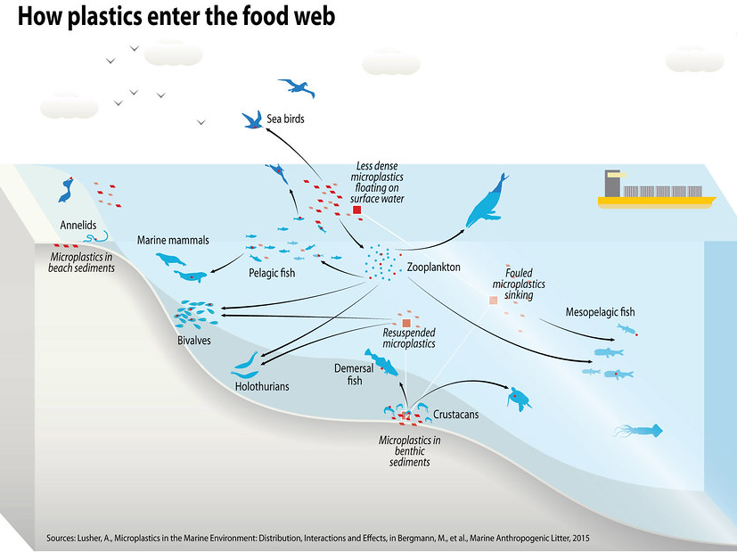

Slide 8
Plastic bioaccumulation in the food web
Zooplankton and other invertebrates ingest plastic particles and fibres
Zooplankton usually excrete the particles within hours but microplastics may remain in the organism for up to seven days in laboratory conditions
Ingestion of polystyrene particles by zooplankton significantly decreases their nutritional intake, since plastic provides zero energy, and may affect how these organisms deal with food shortages
Microplastics affect also reproduction
Zooplankton is at the base of the food web, so higher levels of consumers accumulate larger amounts of plastics

Slide 9
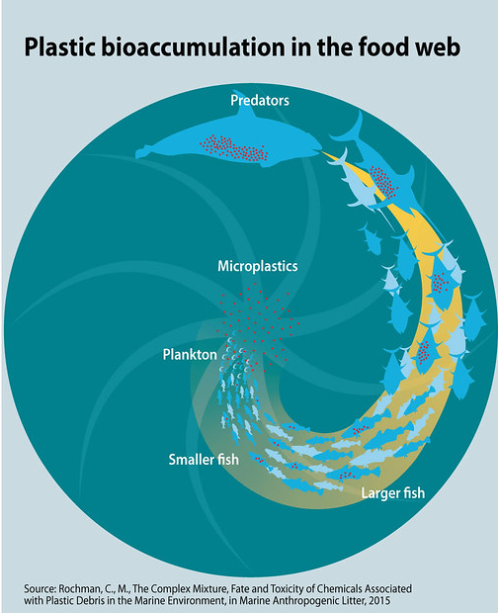
Microplastics are ingested by zooplankton.
Zooplankton is the main food for smaller fish, eaten themselves by larger fish and marine mammals.
Bigger amounts of plastic particles may be found at the top of the food web.

Slide 10
How microplastics could end up on a consumer's plate
The risk of exposure of humans to microplastics and chemicals adhering to them is still studied
The consumption of fish is considered low-risk as the internal organs of fish are usually taken away during fish cleaning
Sea organisms consumed with their internal organs may have microplastics in them
The amount of hazardous chemicals attached to plastic particles is at present considered minor in comparison to other exposure pathways, such as consumption of fruits and vegetables treated with herbicides and atmospheric pollution

Slide 11
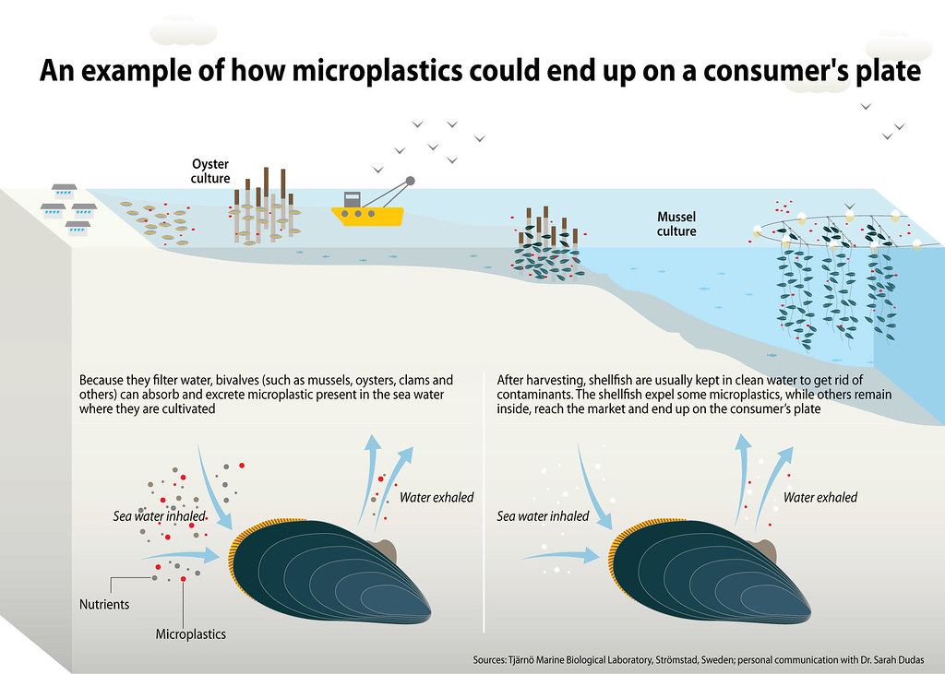

Slide 12
Summary
Microplastics and nanoparticles enter the marine environment and are constantly transported by natural processes
They may affect the ecosystems
There is a risk of bioaccumulation of microplastics in the food web
Seafood is posing a low risk from plastic pollution to humans at present but the issue is under study

Slide 13
Credits
All figures in this presentation are produced by Maphoto/Riccardo Pravettoni, 2016 & 2018 and are part of the collection Marine Litter Vital Graphics of GRID-Arendal, available at: https://www.grida.no/resources/6933
The images are licenced under CC BY-NC-SA 2.0.

Slide 14
Joint Operational Programme Black Sea Basin 2014–2020
The publication is edited by the Black Sea NGO Network
Varna, November 2020
Joint Operational Programme Black Sea Basin 2014–2020 is co-financed by the European Union through the European Neighbourhood Instrument and by the participating countries: Armenia, Bulgaria, Georgia, Greece, Republic of Moldova, Romania, Turkey and Ukraine
This publication has been produced with the financial assistance of the European Union. The contents of this publication are the sole responsibility of the Black Sea NGO Network and can in no way be taken to reflect the views of the European Union

